Slide 1

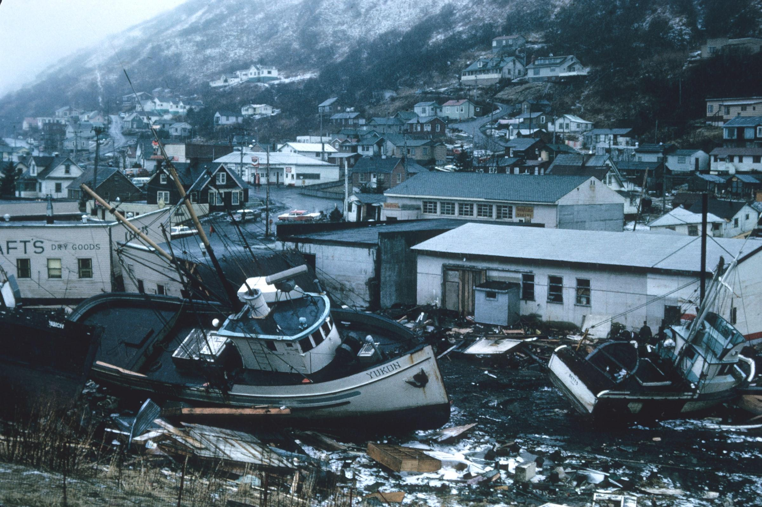
Natural Hazards
Impacts and Responses
Classroom & Distance Learning
Google Classroom

Slide 2
Lesson Roadmap - Recommended
Time (% of lesson) | Lesson Element
0%-5% | Starter Activity This is intended to have students engaged and intrigued from the moment they walk into the classroom, thereby helping to manage behaviour effectively.
5%-50% | Learning Perhaps initially teacher-led but always predominantly student-focused
50%-55% | Mini Plenary Teacher applies assessment for learning - perhaps some off-the-cuff quiz questions, or a mini-whiteboard activity.
55%-95% | Application of Learning Students work through a series of graded tasks / questions in order to test their knowledge of what they self-learned or peer learned/taught. Creative writing element can be a homework option due to time constraints.
95%-100% | Final Plenary Check student progress against class objectives

Slide 3
Starter Activity

Slide 4
Starter Activity
Where do you think this is?
What has happened?
How are people affected?
Stretch & Challenge
How can a country better prepare for this?
How might a country respond to this disaster?
Notes:
Students to focus on class immediately. Engage all students.

Slide 5
Learning
& Mini-Plenary

Slide 6
Natural Hazards
02. Impacts and Responses

Slide 7
Lesson Objectives
In today’s class, we will:
Find out how natural hazards affect people
How people respond to them
Notes:
Plenary will link back to these class objectives

Slide 8
Let’s find out how natural hazards affect people and how people respond to them

Slide 9
Natural Hazards have Primary And Secondary Effects
The Primary effects of natural disasters are the immediate impacts caused by the hazard itself
The Secondary effects of natural disasters occur later on, usually as a result of the primary effects

Slide 10
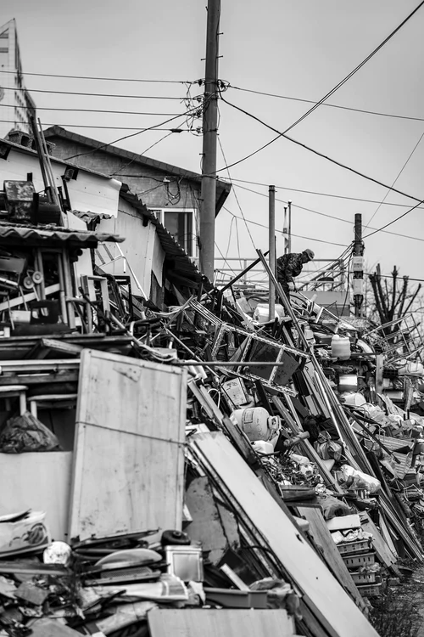
Does this photograph show the primary or secondary effects of an earthquake?
Discuss with your partner.
Notes:
Ask students to illicit what is meant by secondary and secondary impacts - what examples can they think of. Teacher can note these on whiteboard.

Slide 11
It’s time for our first task - let’s find out more about Primary and Secondary effects

Slide 12

Task: Pairwork
Primary Effects of a natural hazard | Secondary Effects of a natural hazard
You will work in pairs
Partner A will take notes about Primary effects of natural hazards
Partner B will take notes about Secondary effects of natural hazards
You will then peer teach each other and complete the table
Notes:
Give students table template each to complete. MS Word version available.

Slide 13
Primary Effects Secondary Effects
Buildings and roads are destroyed
A shortage of clean drinking water
Notes:
Students to provide feedback to the class / teacher. Teacher to make notes on whiteboard in order to gives students extra opportunity to record key points.

Slide 14
Secondary Effects
The initial disaster can trigger other hazards, for example earthquakes can trigger tsunamis which are colossal waves created by seawater being displaced. Tsunamis can decimate homes, roads and directly claim lives. Emergency vehicles cannot get through to help people because of blocked roads and collapsed bridges, which can result in more deaths, as people are unable to receive medical treatment. A lack of clean water and a shortage of adequate sanitation makes it easier for disease to spread. Food and water shortages can occur if crops are damaged, livestock is killed and supply lines are obstructed. The country's economy can be diminished because of damage to businesses which leads to rising unemployment. Reconstruction costs are very high, and even more troublesome for poorer countries. Other examples of secondary effects may include power outages due to fallen trees, meaning no heating and hot water for many people.
Primary effects
The primary effects of natural disasters are the immediate impacts caused by the hazard itself. Buildings and roads are destroyed by earthquakes, volcanic eruptions or tropical storms. People are injured or killed, sadly, and this happens when buildings collapse on them. Their homes are wrecked leaving them homeless and hungry. Crops can be damaged, contaminated or completely destroyed. Water pipes may rupture and water supplies may be contaminated. Animal habitats can be critically impacted. Electricity cables, gas pipes and communication networks can be crippled, therefore cutting off supplies. Fires can spread due to gas pipe explosions and they extend to damage areas of woodland and other important habitats. Landslides may occur after heavy rainfalls, especially after tropical storms.
Notes:
Resource1: To be cut in half and given to student A and Student B in each pair. MS Word version available.

Slide 15
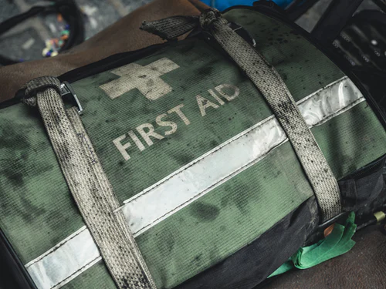
Primary and Secondary impacts lead to Immediate and Long-term Responses

Slide 16

Immediate and Long-Term Responses
Immediate Responses
Some impacts have to be managed before, during or immediately after the natural disaster to prevent further loss of life, injuries or damage to property, roads and wildlife habitats.
2. Long-Term Responses
Other impacts have to be handled in the longer-term as the country tries to recover from the natural disaster.
Task: with your partner, note down some possible immediate and L-T responses
Notes:
Allow students a few minutes to discuss and note down their thoughts. Students then feed back to the class and teacher. Teacher to note student ideas on whiteboard to collate all student responses.

Slide 17
There are two types of response: Immediate and Long-Term
Immediate Responses | Long-Term Responses
Task: Information sort
Students will sort responses into two different categories: immediate and long-term
Notes:
Provide a table template to each student - they perform a wall crawl to obtain the information. They work alone.

Slide 18
Evacuate people before the hazard occurs if possible | Rebuild homes or rehouse those people who have lost their homes
Provide medical treatment to the injured and rescue anybody cut off by damage to roads or bridges | Repair or reconstruct buildings, roads, harbours, railways, airports and bridges
Recover dead bodies in order to prevent disease spreading | Re-establish broken gas, electricity, water and communication services
Arrange and provide temporary supplies of electricity and gas if regular supply network has been damaged | Improve prediction, forecasting, monitoring and evacuation plans and processes
Provide food, drink and shelter to all those people whom have lost homes | Improve building standards and regulations so that future buildings can withstand similar hazards in the future
Foreign governments and international charities may provide aid workers, food and medical supplies or financial donations | Stimulate economic recovery by promoting tourism and encouraging international investment
Notes:
RESOURCE 2: Students work in pairs and cut out strips and sort into Immediate and Long-Term Responses.

Slide 19
Immediate Responses | Long-Term Responses
Evacuate people before the hazard occurs if possible Provide medical treatment to the injured and rescue anybody cut off by damage to roads or bridges Recover dead bodies in order to prevent disease spreading Arrange and provide temporary supplies of electricity and gas if regular supply network has been damaged Provide food, drink and shelter to all those people whom have lost homes Foreign governments and international charities may provide aid workers, food and medical supplies or financial donations | Rebuild homes or rehouse those people who have lost their homes Repair or reconstruct buildings, roads, harbours, railways, airports and bridges Re-establish broken gas, electricity, water and communication services Improve prediction, forecasting, monitoring and evacuation plans and processes Improve building standards and regulations so that future buildings can withstand similar hazards in the future Stimulate economic recovery by promoting tourism and encouraging international investment
Notes:
Provide template sheer to students

Slide 20
Immediate Responses are those that occur straight away!

Slide 21
Application of Learning

Slide 22
Application of Learning Tasks
What is a primary effect of a natural hazard? Give an example.
What is a secondary effect of a natural hazard? Give an example.
Explain why secondary effects are usually a result of primary effects.
Compare and contrast immediate and long-term responses to natural hazards.
Give three examples of immediate responses to natural disasters.
Give three examples of long-term responses to natural disasters.
Why might it be difficult to evacuate people before a natural disaster in some countries?
How might poor building standards and regulations impact people in the event of a natural hazard?
Stretch & Challenge:
Explain why a wealthy HIC is likely to experience lower death rates than an LIC even if both countries experienced identical magnitude natural disasters.
Financial donations from HICs to LICs after a natural disaster do not help the LIC in the longer-term. Explain.
Notes:
All tasks are based on content found in teacher resources.
Green-coloured questions offer the least challenge for students but nonetheless are essential in assessing for basic understanding of lesson concepts. These would equate to 1-2 mark exam questions where basic understanding is tested.
Amber-coloured questions offer more challenge than green-coloured questions. These are intended to check more more comprehensive understanding about the lesson content where the student will be expected to compare and contrast, or explain concepts in more detail. These would equate to 2-3 mark exam questions.
Red-coloured questions are a higher challenge question where students will be expected to tie in different lesson concepts, and consider effects, impacts, threats, vulnerabilities from a social, economic, environmental, technological and even political perspective. Students are expected to think in a more dynamic context rather than in just a linear fashion, in order to give deeper explanation or discussion about concepts and topics. These equate to 4-8 mark exam questions.
Purple-coloured questions are designed to test the most highly capable students, thereby stretch and challenge them. These questions, whilst relevant to the lesson content, will expect students to draw upon their wider geographical knowledge and utilise knowledge from other geography topics, not to mention current affairs and general knowledge. Students will be expected to think critically and to provide deeper insight, opinion, discussion and explanation in their responses. Stretch and Challenge tasks are designed to do exactly as the term suggests. This allows talented students to think more outside the box and utilise wider academic knowledge they may have.

Slide 23
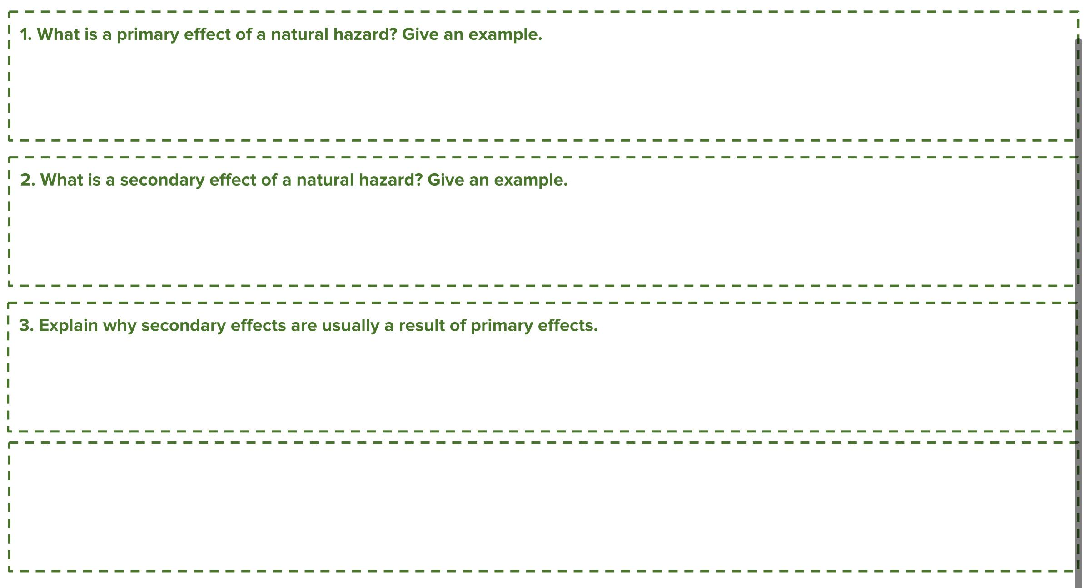
Type answer here
Type answer here
Type answer here
Type answer here
Notes:
Green-coloured questions offer the least challenge for students but nonetheless are essential in assessing for basic understanding of lesson concepts. These would equate to 1-2 mark exam questions where basic understanding is tested.

Slide 24
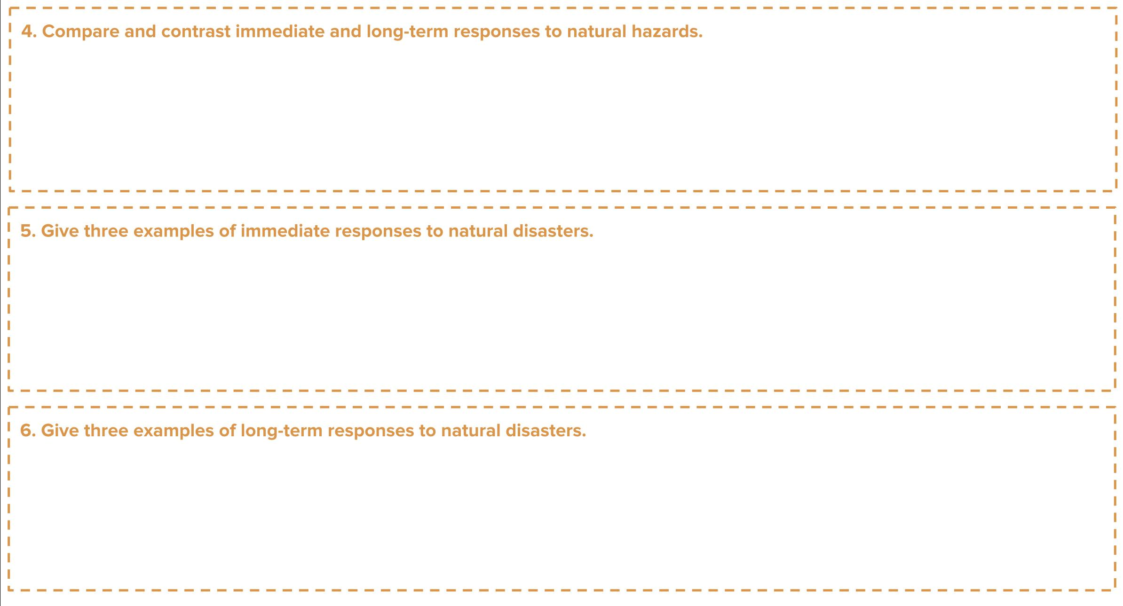
Type answer here
Type answer here
Type answer here
Notes:
Amber-coloured questions offer more challenge than green-coloured questions. These are intended to check more more comprehensive understanding about the lesson content where the student will be expected to compare and contrast, or explain concepts in more detail. These would equate to 2-3 mark exam questions.

Slide 25
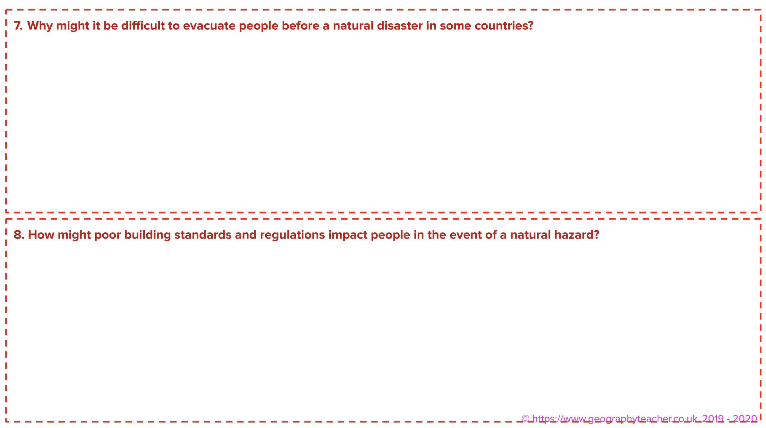
Type answer here
Type answer here
Notes:
Red-coloured questions are a higher challenge question where students will be expected to tie in different lesson concepts, and consider effects, impacts, threats, vulnerabilities from a social, economic, environmental, technological and even political perspective. Students are expected to think in a more dynamic context rather than in just a linear fashion, in order to give deeper explanation or discussion about concepts and topics. These equate to 4-8 mark exam questions.

Slide 26
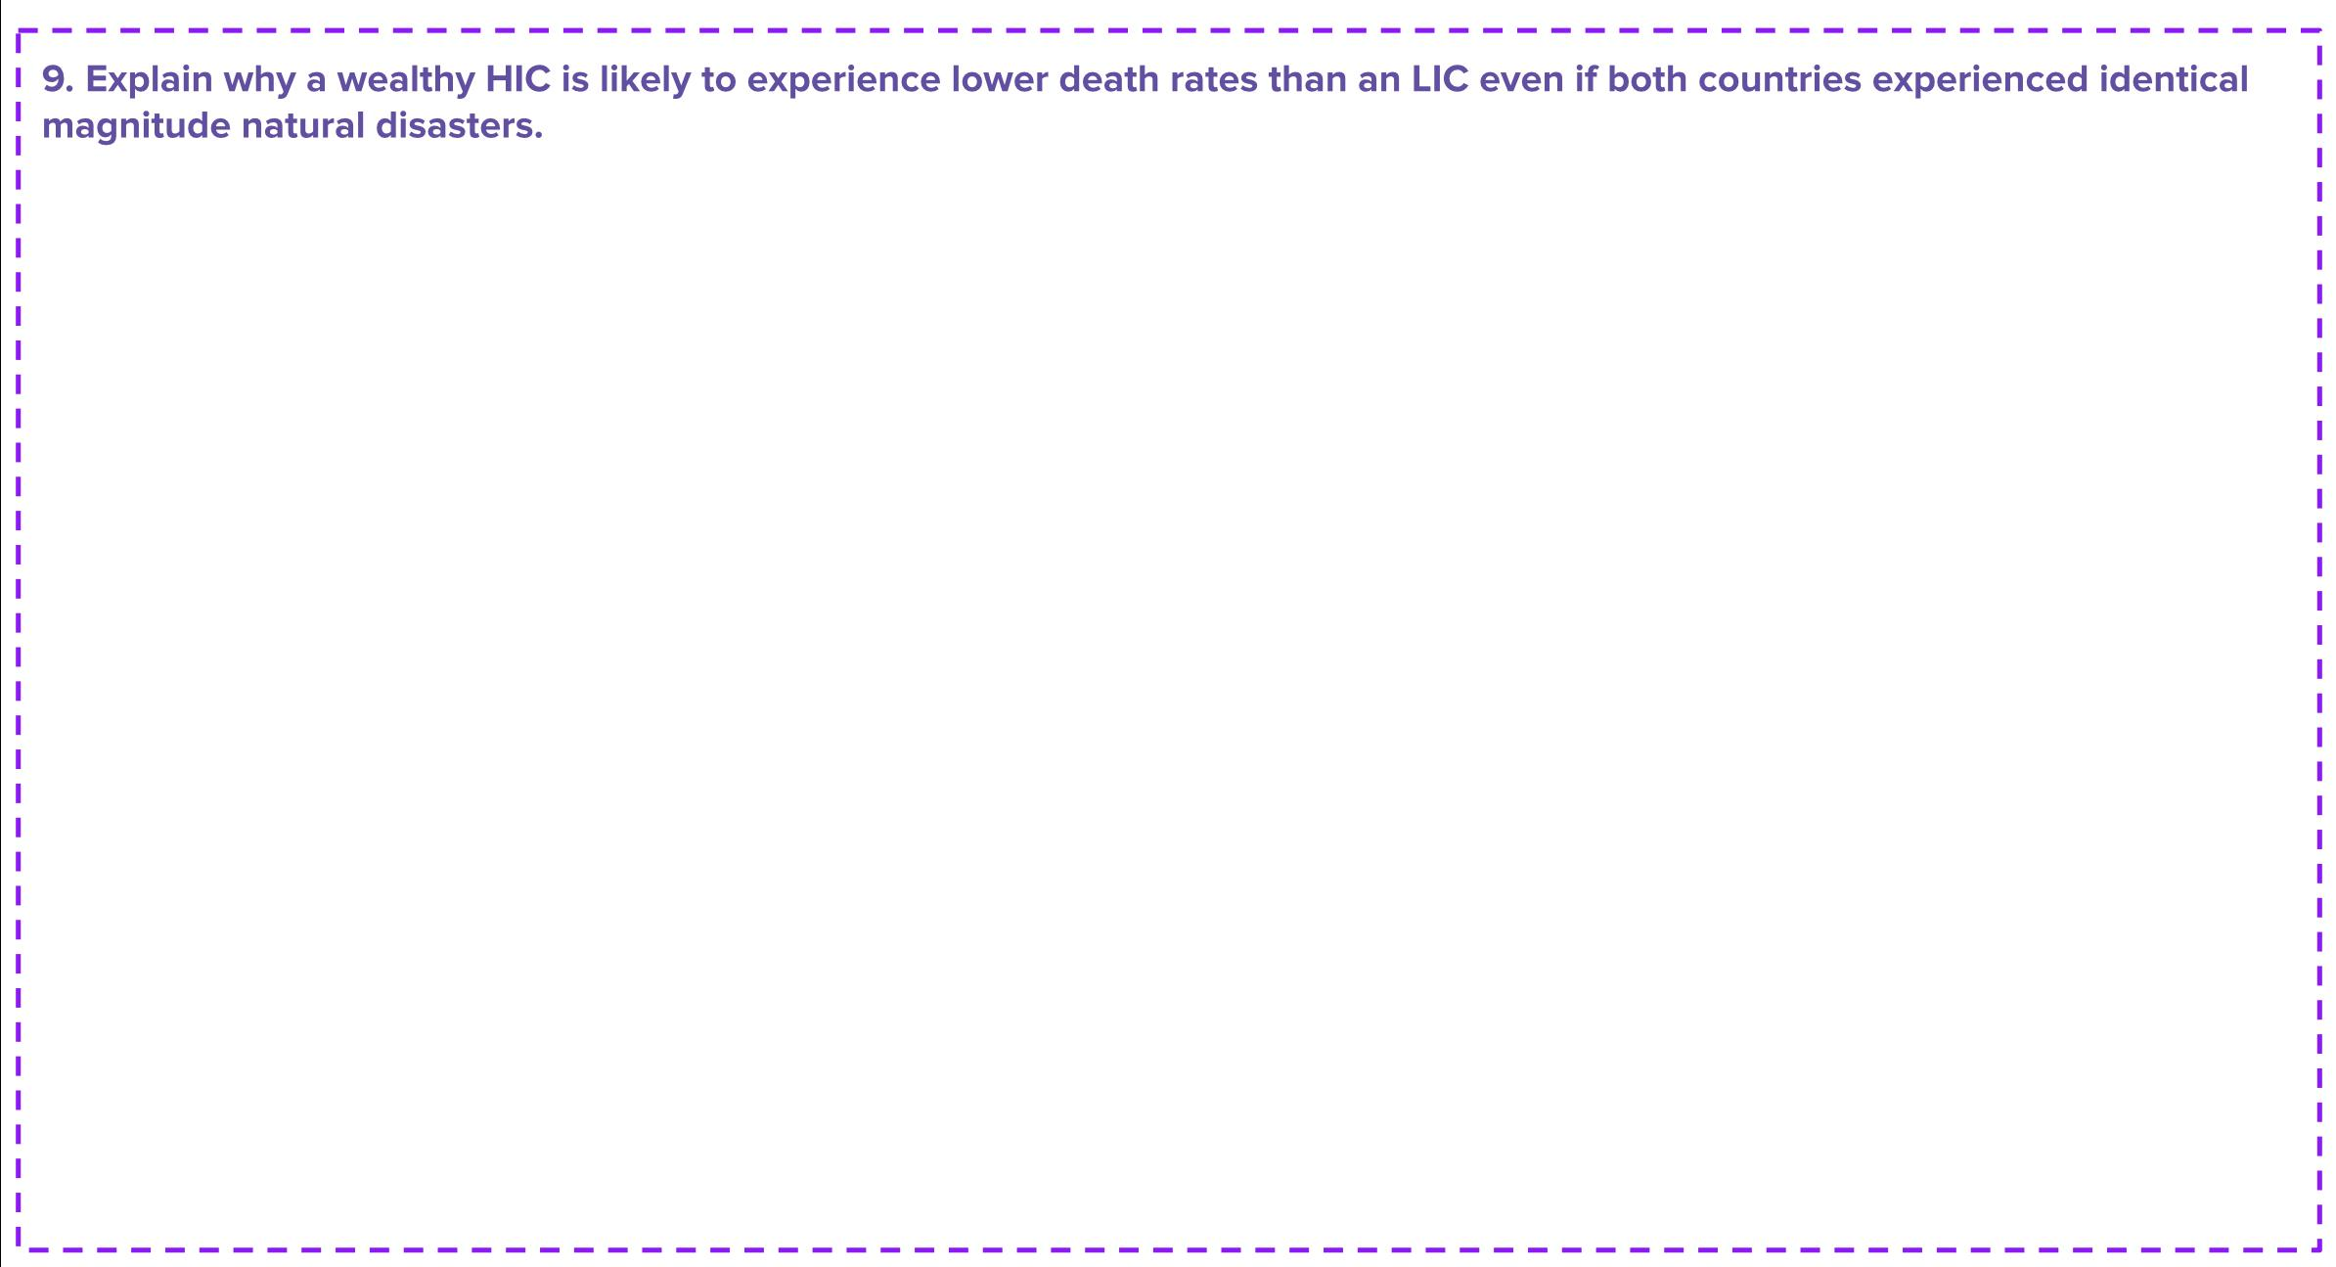
Type answer here
Notes:
Purple-coloured questions are designed to test the most highly capable students, thereby stretch and challenge them. These questions, whilst relevant to the lesson content, will expect students to draw upon their wider geographical knowledge and utilise knowledge from other geography topics, not to mention current affairs and general knowledge. Students will be expected to think critically and to provide deeper insight, opinion, discussion and explanation in their responses.

Slide 27
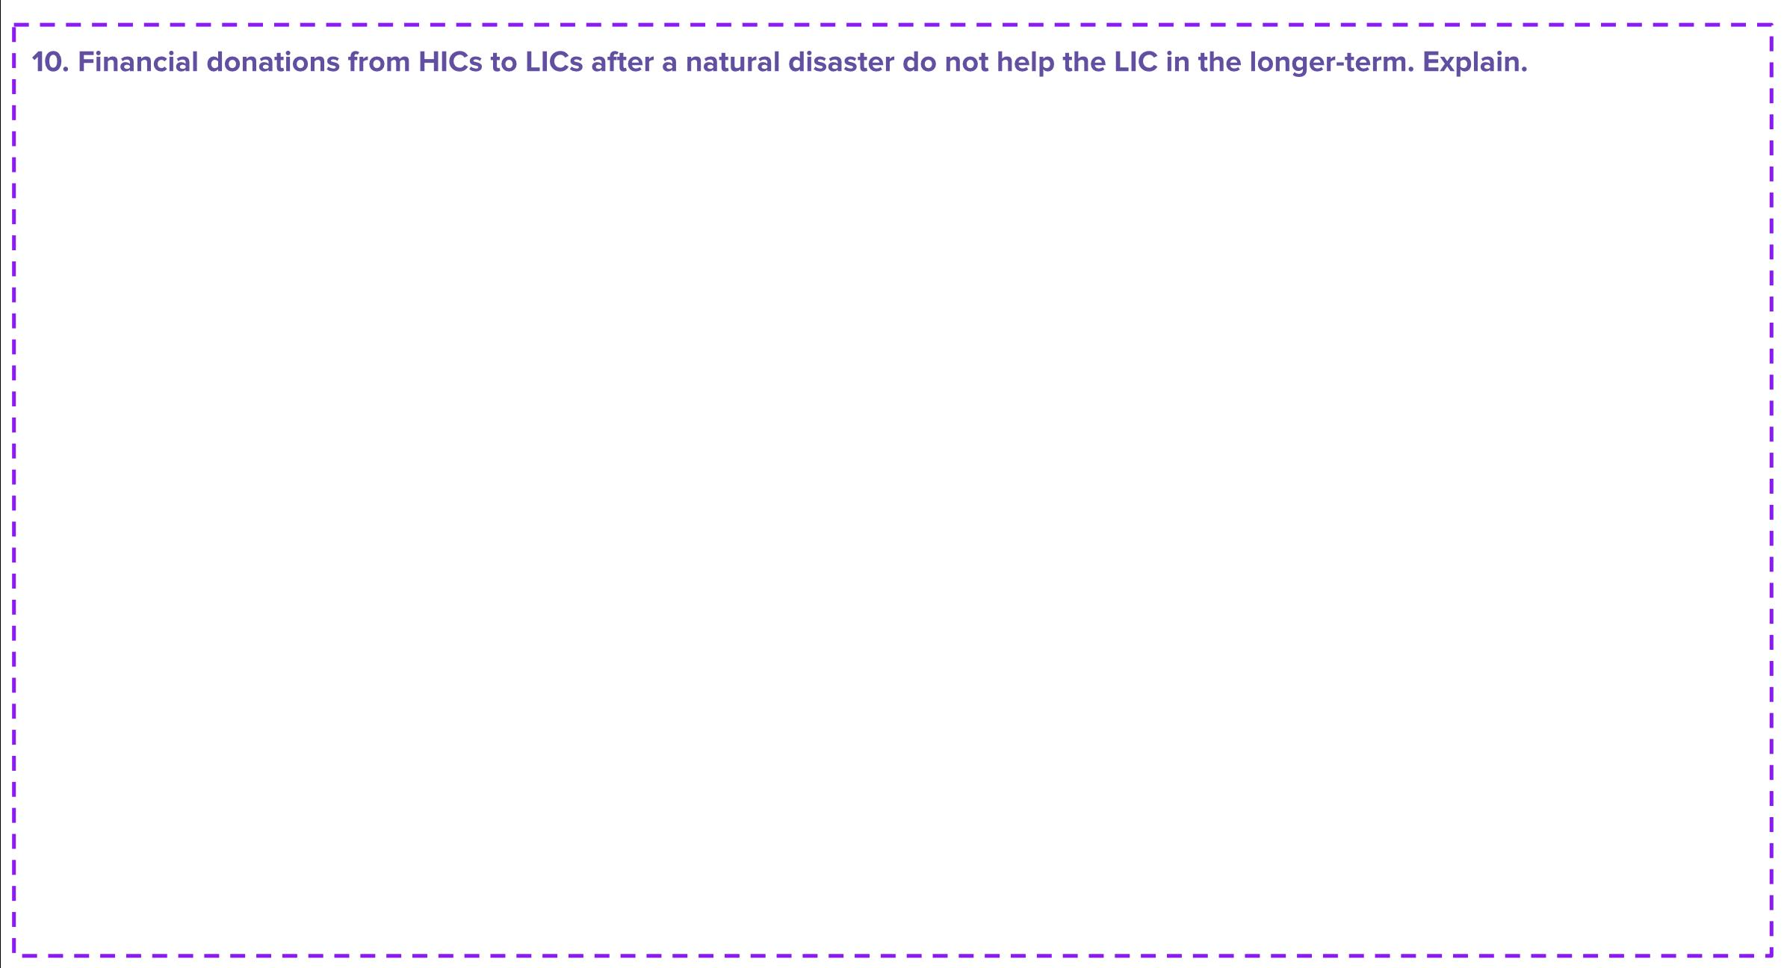
Type answer here
Notes:
Purple-coloured questions are designed to test the most highly capable students, thereby stretch and challenge them. These questions, whilst relevant to the lesson content, will expect students to draw upon their wider geographical knowledge and utilise knowledge from other geography topics, not to mention current affairs and general knowledge. Students will be expected to think critically and to provide deeper insight, opinion, discussion and explanation in their responses.

Slide 28

President’s Response Plan
You are the President of a small Caribbean nation which has just been decimated following a deadly natural disaster. Your island has a population of 10,000 and most employment is in farming and tourism. Early news reports state that there have been many fatalities, with homes, schools and the airport being destroyed. Write an emergency response plan, detailing what needs to be done immediately, and Long-Term.
Notes:
Refer to writing frame to help students

Slide 29
Writing Framework
What do you think language
I think that…
I believe…
In my opinion…
In my view…
It is my belief that …
It is clear to see…
Give examples
Such as
In the case of
For example
As revealed by
For instance
Explain an idea
Although
Except
Unless
However
Therefore
Sequencing
Firstly
Secondly
Next
Finally afterwards
Since
Adding to
And
Also
As well as
Moreover
Too
Furthermore
Cause and effect
Because
So
Therefore
Consequently
Thus
Contrasting
Whereas
Instead of
Alternatively
Otherwise
In another way
Then again
Elaborating your ideas
This suggests
This shows
This infers
This signifies
This implies
This portrays
This conveys
This means
Therefore
However
Furthermore
To emphasise
Above all
Ultimately
Especially
Significantly
To compare
Likewise
Equally
In the same way
Similarly
Notes:
Writing framework to help students with their creative writing tasks.

Slide 30
Final Plenary

Slide 31
Plenary
The two different types of natural hazard impacts are known as …….
Buildings destroyed by an earthquake are a secondary impact. True or false?
We have learned that there are _______________ and ______________ responses to a natural hazard.
Evacuating people before a natural hazard is an immediate response. True or false?
Charity and aid workers are a long-term response. True or False?
How do natural disasters affect people? Give three examples.

Slide 32


Retweet
Retweet an answer to the question in no more than 140 characters:
Question:
Notes:
Students or teacher to provide write an end-of-lesson plenary question to assess student learning. Student is given 5 minutes to provide an answer to the question, on no more than 140 characters.
Students can share questions and answers in class.
This provides the teacher with useful assessment for learning feedback on the individual student ot the entire class.

Slide 33

Retweet an answer to the question in no more than 140 characters
Type plenary question here
Notes:
Students or teacher to provide write an end-of-lesson plenary question to assess student learning. Student is given 5 minutes to provide an answer to the question, on no more than 140 characters.

Slide 34
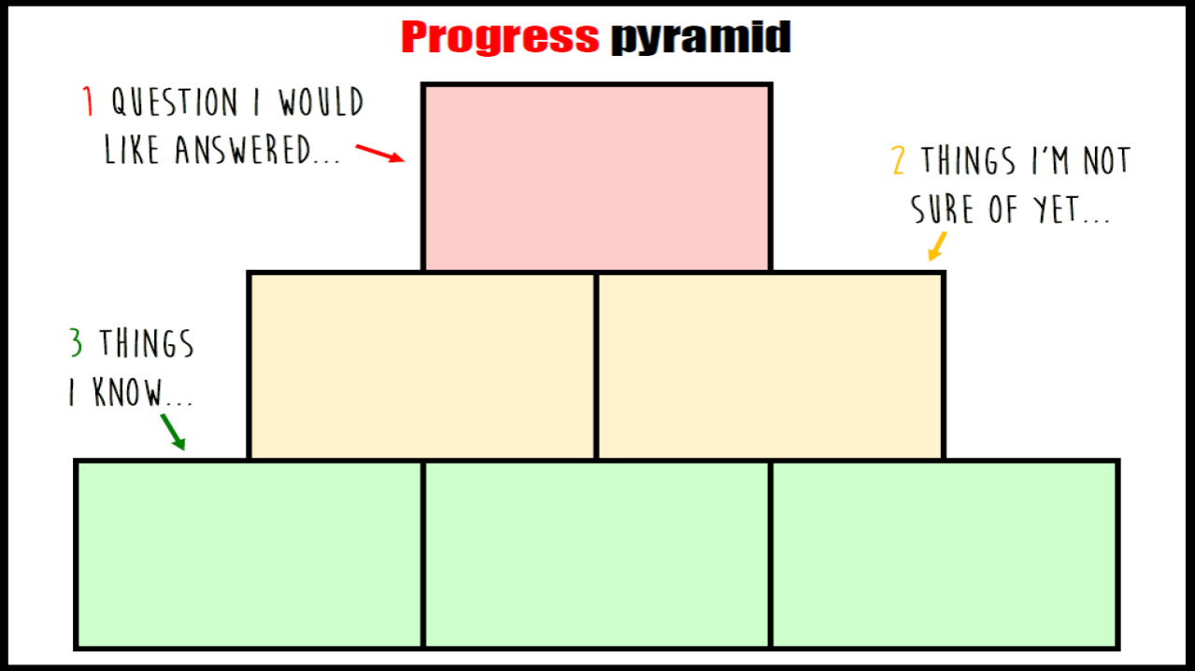
Notes:
Classroom written version

Slide 35
Type here
Type here
Type here
Type here
Type here
Type here
Notes:
Online distance learning digital text input version

Slide 36
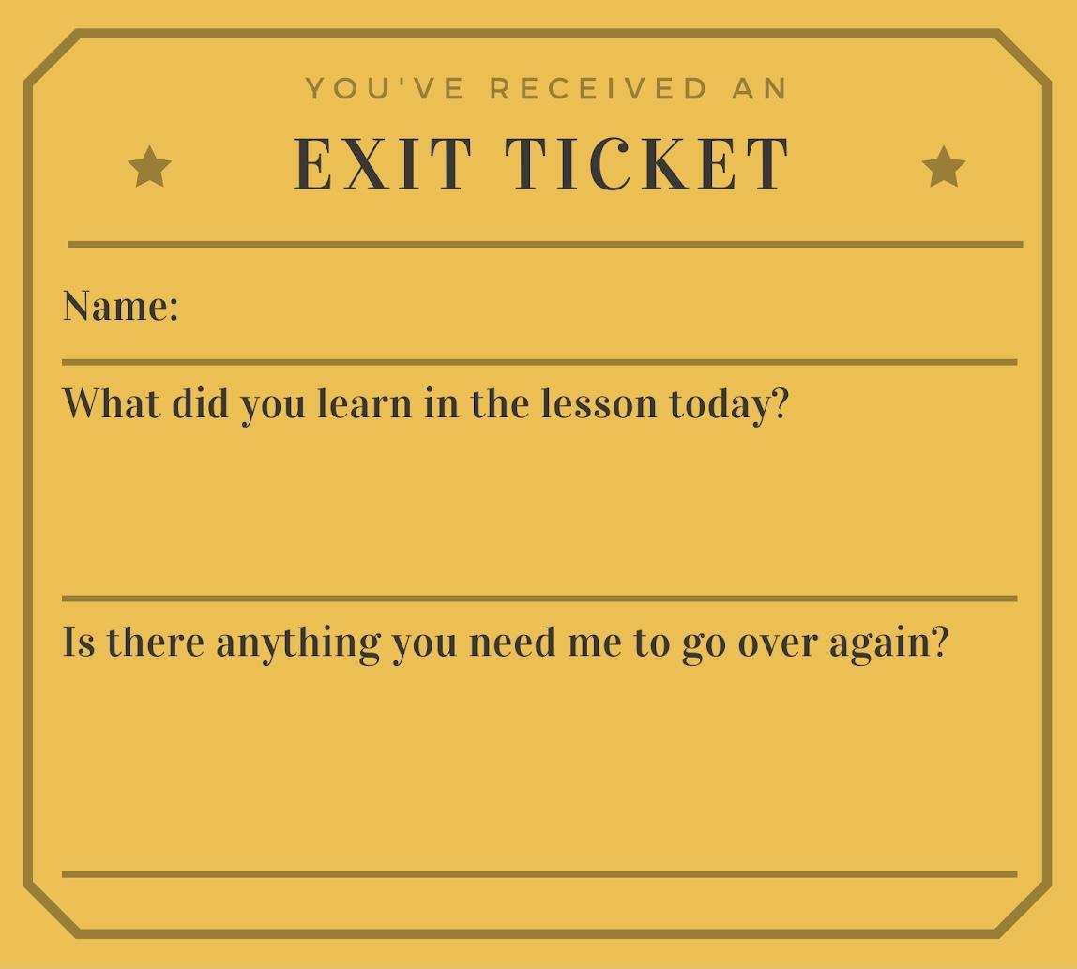
Notes:
Exit cards for - Assessment for Learning

Slide 38
Teacher Resources

Slide 39
Secondary Effects
The initial disaster can trigger other hazards, for example earthquakes can trigger tsunamis which are colossal waves created by seawater being displaced. Tsunamis can decimate homes, roads and directly claim lives. Emergency vehicles cannot get through to help people because of blocked roads and collapsed bridges, which can result in more deaths, as people are unable to receive medical treatment. A lack of clean water and a shortage of adequate sanitation makes it easier for disease to spread. Food and water shortages can occur if crops are damaged, livestock is killed and supply lines are obstructed. The country's economy can be diminished because of damage to businesses which leads to rising unemployment. Reconstruction costs are very high, and even more troublesome for poorer countries. Other examples of secondary effects may include power outages due to fallen trees, meaning no heating and hot water for many people.
Primary effects
The primary effects of natural disasters are the immediate impacts caused by the hazard itself. Buildings and roads are destroyed by earthquakes, volcanic eruptions or tropical storms. People are injured or killed, sadly, and this happens when buildings collapse on them. Their homes are wrecked leaving them homeless and hungry. Crops can be damaged, contaminated or completely destroyed. Water pipes may rupture and water supplies may be contaminated. Animal habitats can be critically impacted. Electricity cables, gas pipes and communication networks can be crippled, therefore cutting off supplies. Fires can spread due to gas pipe explosions and they extend to damage areas of woodland and other important habitats. Landslides may occur after heavy rainfalls, especially after tropical storms.
Notes:
Resource1: To be cut in half and given to student A and Student B in each pair. MS Word version available.

Slide 40
Evacuate people before the hazard occurs if possible | Rebuild homes or rehouse those people who have lost their homes
Provide medical treatment to the injured and rescue anybody cut off by damage to roads or bridges | Repair or reconstruct buildings, roads, harbours, railways, airports and bridges
Recover dead bodies in order to prevent disease spreading | Re-establish broken gas, electricity, water and communication services
Arrange and provide temporary supplies of electricity and gas if regular supply network has been damaged | Improve prediction, forecasting, monitoring and evacuation plans and processes
Provide food, drink and shelter to all those people whom have lost homes | Improve building standards and regulations so that future buildings can withstand similar hazards in the future
Foreign governments and international charities may provide aid workers, food and medical supplies or financial donations | Stimulate economic recovery by promoting tourism and encouraging international investment

Slide 41
 | Social | Economic | Cultural | Other
Primary Effects of a Natural Hazard
Secondary Effects of a Natural Hazard
Notes:
Alternative for students - classifying impacts into economic, cultural and social

Slide 42
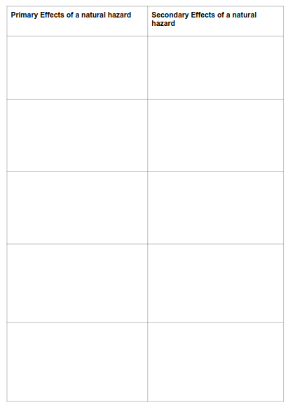
Notes:
Template worksheet for students

